Slide 1
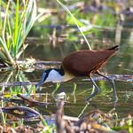
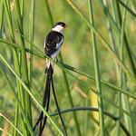
Identifying Tanzanian Birds with Neural Networks
Brendan Quinn
Notes:
(Fullscreen box)
Here to talk about
/read slide/

Slide 2
Table of Contents
01
02
03
04
05
About Me
Tanzania & Birds
Data & Model
Results
Next Steps
Notes:
Today we’ll cover
A few words about me
Tanzania, birds, and the problem we are trying to solve
How I tried to solve that problem
My Results
What to do next

Slide 3
01
About Me
Notes:
Let’s get started

Slide 4

Hello!
Brendan Quinn
Data Scientist
Software Developer
Birding Enthusiast
Notes:
/read slide/
Today, I’m combining all 3 of my passions STOP

Slide 5
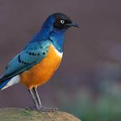
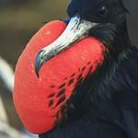
02
Tanzania & Birds
Notes:
Here’s our context:

Slide 6
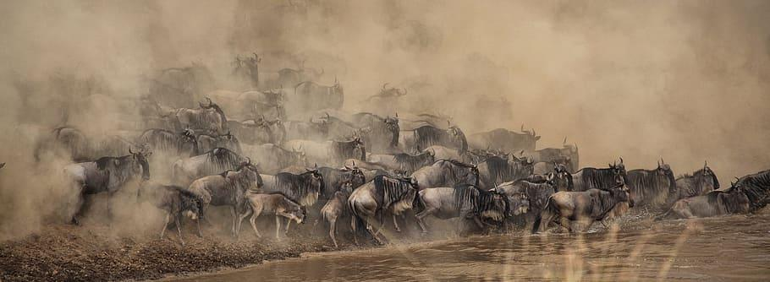
Tanzania
Diverse Population
Main Industries
Vast Natural Beauty
56,000,000+ people
Over 100 languages spoken
Agriculture
Mining
Tourism
38% of land is protected
Home of Mt Kilimanjaro
About 11% of all bird species found here
Notes:
Tanzania
Diverse population STOP
> 11% birds

Slide 7
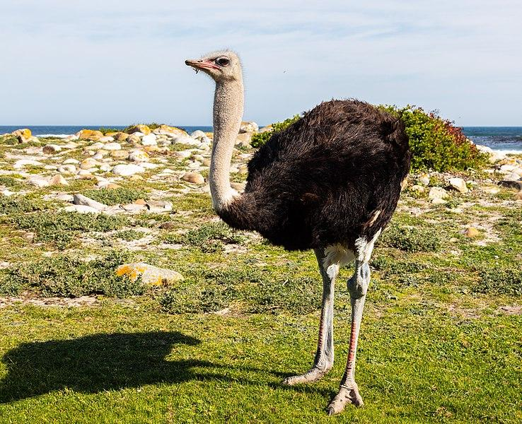
You probably know what this is
(It’s an Ostrich)
Notes:
/Read Slide?

Slide 8
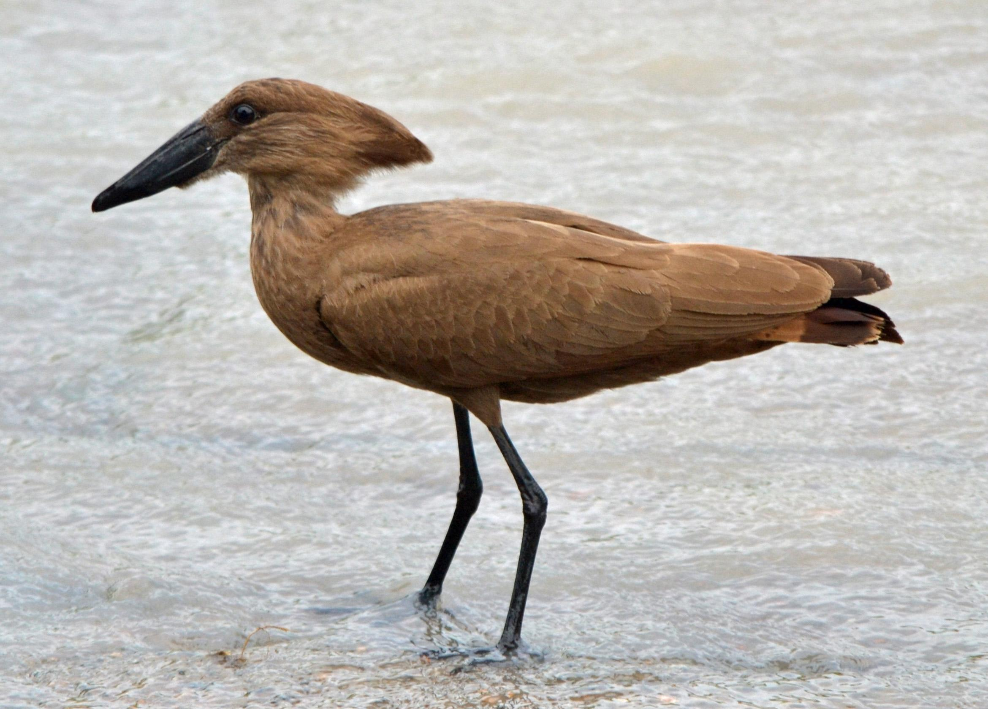
Maybe not this one...
(It’s a Hamerkop)
Notes:
/read slide/
That’s our problem: how do we identify all these birds?

Slide 9
With machine learning, identifying birds can be easy!
Notes:
So we understand the problem now but
/read slide/

Slide 10
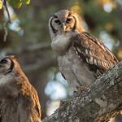
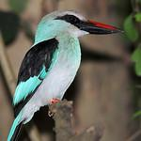
03
Data & Model

Slide 11
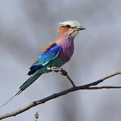
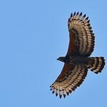
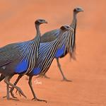
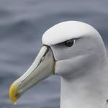
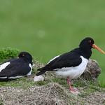
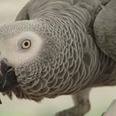
The Data
Over 1,000,000 images representing 1000+ species via Flickr API.
Due to time constraints, distilled down to ~57,000 pictures representing 355 species
Notes:
Most Popular, Visible Birds

Slide 12
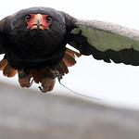
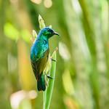
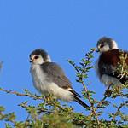
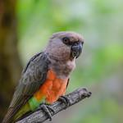
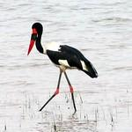
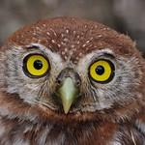
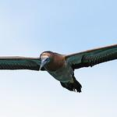
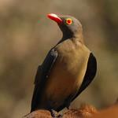
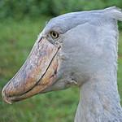
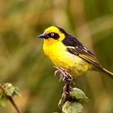
Notes:
That’s still a lot of birds!
How can we use ML to ID them?

Slide 13
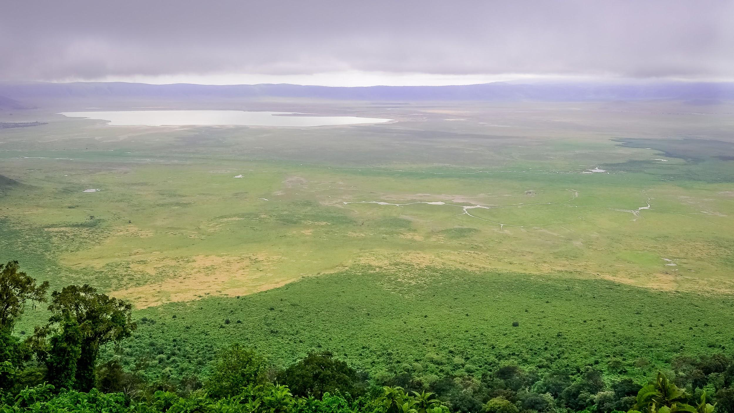

Convolutional Neural Networks
Notes:
NN: A powerful tool inspired by how brains work.
CNN is MAINLY composed of two different types of what are called layers
Convolution Layers: Highlight visual details, such as edges or blurs
Pooling layer: Reduces resolution to boost speed.

Slide 14
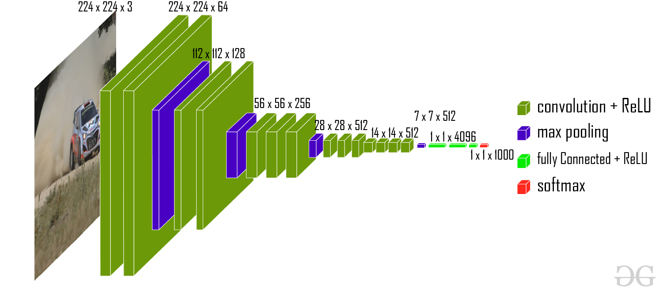
VGG-19
Notes:
Not just any, this pretrained on ImageNet
A massive online database to train Computer Vision software
19 layers per name
Ends in softmax, which makes final decision

Slide 15





Tools Used
Notes:
How did I build this?

Slide 16
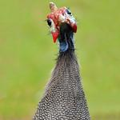
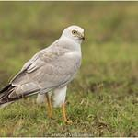
04
Results

Slide 17
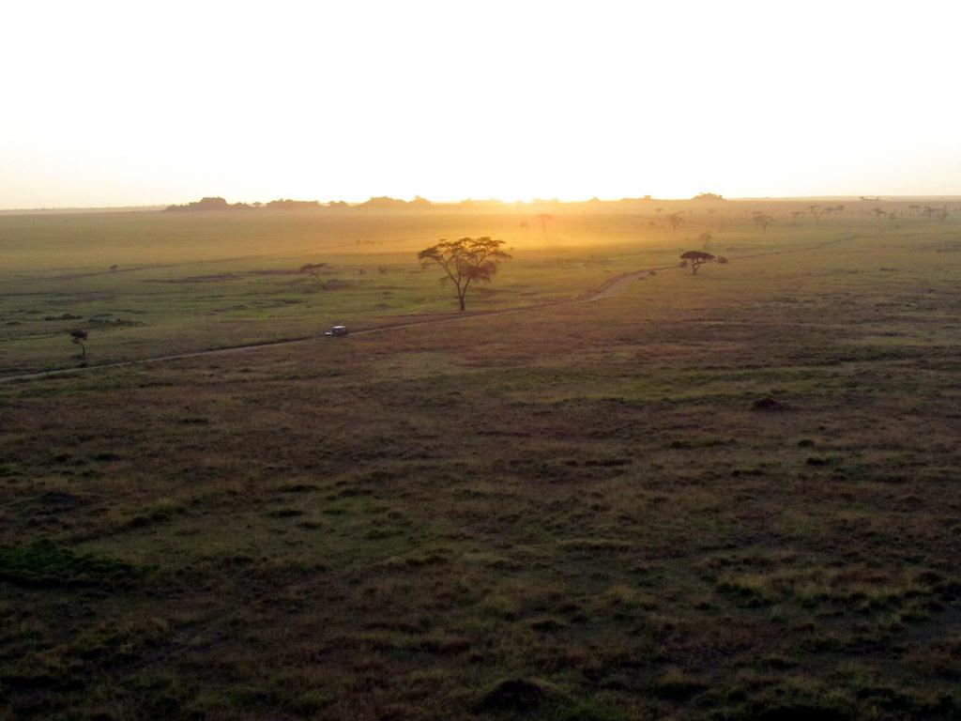
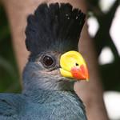
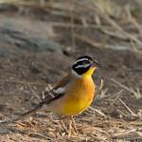
Performance
Model currently can identify the correct bird about 20% of the time.
If it guessed randomly, it would only be correct 0.25% of the time.
Works best on colorful species.

Slide 18
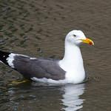
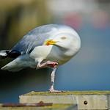
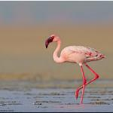
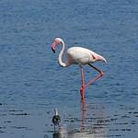
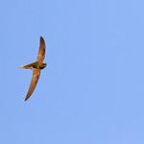
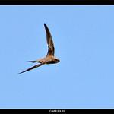
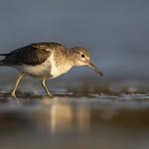
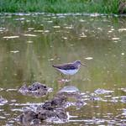
Notes:
Biggest Hurdle: A lot of birds just look the same.
The model thought each of these pairs was the same species.
Every picture is unique species.
I can’t tell these apart haha

Slide 19
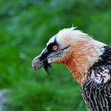
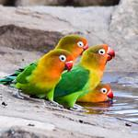
05
Next Steps

Slide 20
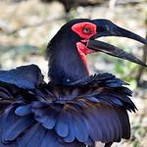
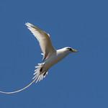
Next Steps
This project could aid the Cornell Lab of Ornithology in their effort to create a mobile app that can identify birds.
With more resources, could train using the original 1,000,000 images.
This would add more species and cause accuracy to soar.
Additional, specialized neural networks could deal with tough ID’s.

Slide 21
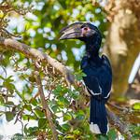
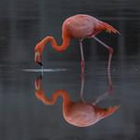
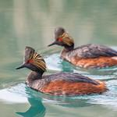
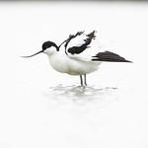
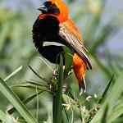
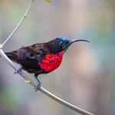






Slide 22
Thank you
for your time!
Any Questions?
Email: brendan.quinn612@zohomail.com
Github: brendanquinn612
Linkedin:
Notes:
Fully-connected: Convolutions that affect the entire image
Merlin

